Slide 1

Integrating Data from Multiple Sources in POWER BI
Group 3 Presentation
Habeeb Omotunde (200584861)

Slide 2

OUTLINE
What is Power BI
Power BI Use cases
Power BI Data Sources
Excel, CSV, WEB, Databases, Azure, & others
Integrating data from multiple sources (Live Session)
Conclusion

Slide 3

What is Power BI
Microsoft Power BI is an interactive data visualization software product developed by Microsoft with a primary focus on business intelligence.
Power BI comprises of 3 part
A Windows desktop application called Power BI Desktop.
An online software as a service (SaaS) service called the Power BI service &
Power BI Mobile apps for Windows, iOS, and Android devices.
Notes:
Business Intelligence deals with deriving actionable insights from a huge collection of data & other repositories

Slide 4

Power BI Use Cases
Data Analysis
Data Cleanup
Data Transformation
Data Aggregation
Data Visualization
Report Design & Generation
Data Modeling
Predictive Analytics
Extensibility / Integration with other tools
Notes:
Data analysis: It provides tools that helps users make sense of data deriving hidden information and actionable insights.

Slide 5
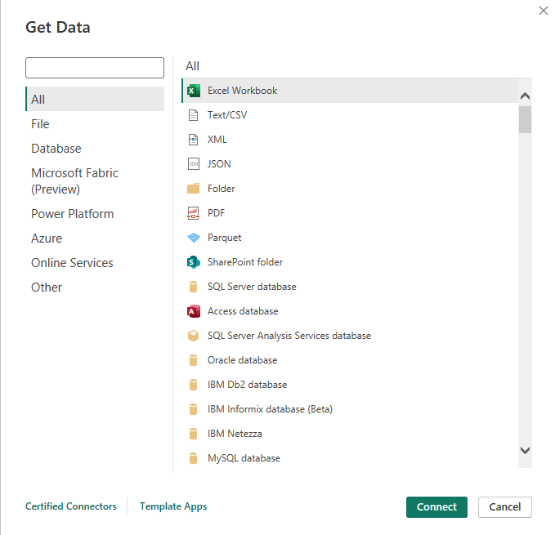
Power BI Data Sources
Power BI can extract data from multiple sources as presented in the figure. Notable sources of interest in this presentation are:
Excel – Customer Churn data
CSV – Office Supplies Data
Databases (SQL Server) – School_Datawarehouse
Web - https://www.fool.com/research/best-states-to-retire

Slide 6
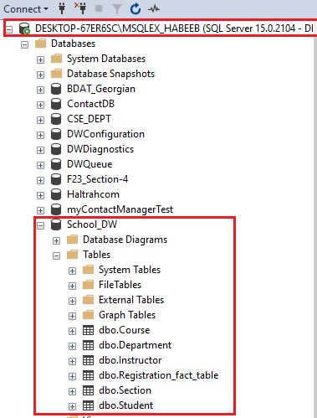
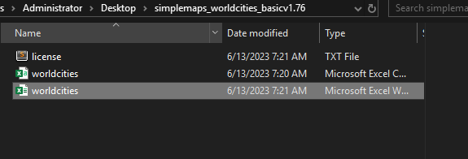
Integrating data from multiple sources (Live Session)
Scenario
The SQL Server contains a School Database (School_DW) which is a data warehouse DB containing several tables such as students, instructors, courses etc. The students table has an address attribute however, it’s important to associate each address (city) with the country and the 3-letter abbreviation of the countries
Data Sources to integrate
Student table from SQL Server
(DESKTOP-67ER6SC\MSQLEX_HABEEB)
World cities data from excel spread sheet – data from https://simplemaps.com/data/world-cities

Slide 7

Conclusion
Power BI is a powerful Business Intelligence tool for driving innovation in organizations and enterprise by processing disparate collections of huge data repositories.
It provides tools for data cleaning, transformation, aggregation, report generation and data visualization to mention a few.

